Slide 1
Fitness Center
By: Md Imran Raj
Aryaman suri
Aprendu Aman
Shivam Hooda

Slide 2
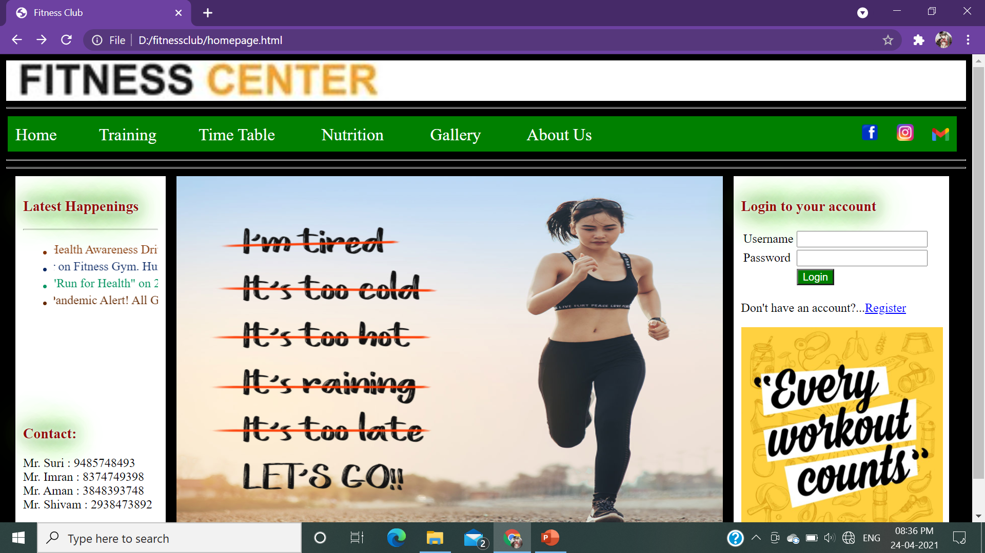
Home Page
Developer: Md Imran Raj
Common menu design for all pages
Moving text
Easy navigation
Links for Social Networking sites
Login option available

Slide 3
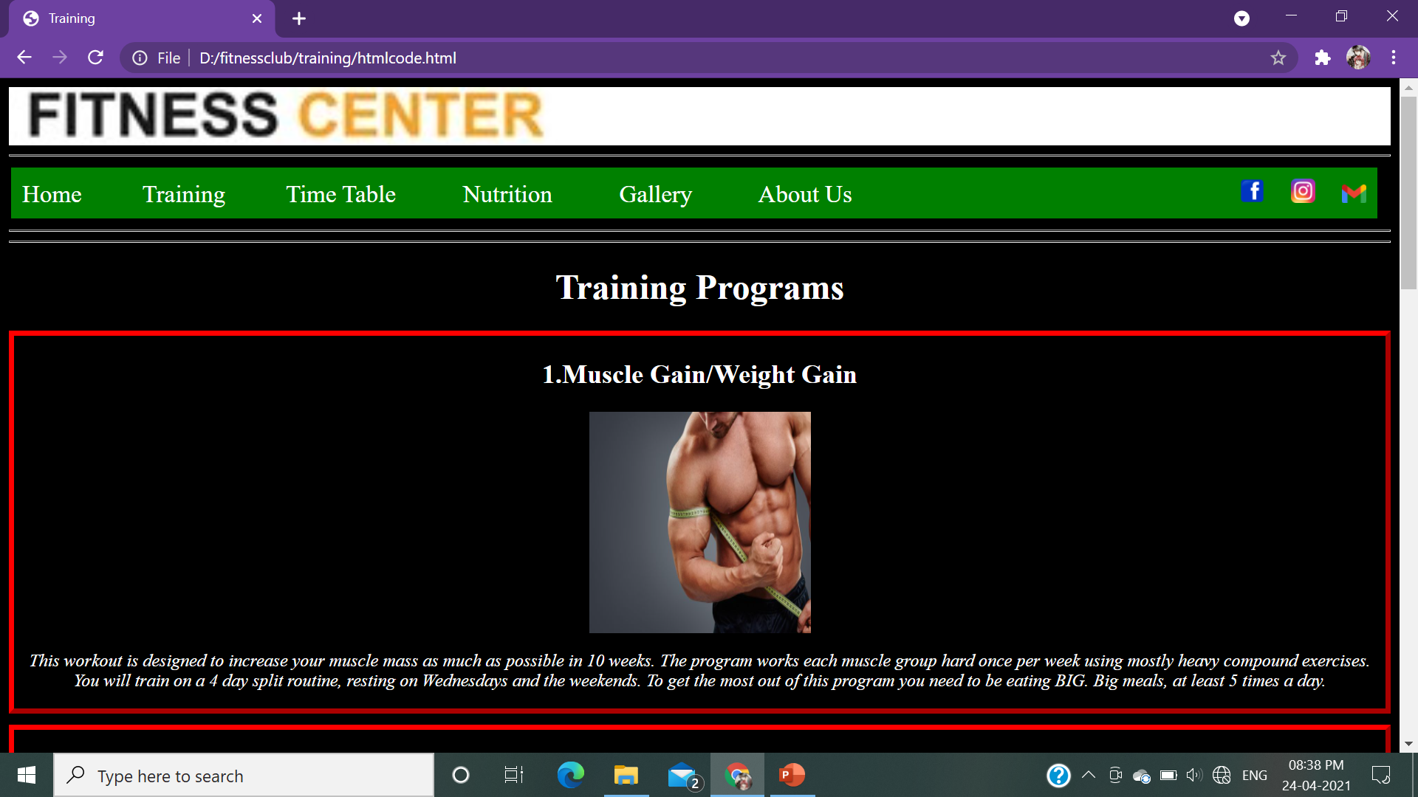
Training Page
Developer: Shivam Hooda
Details on programs provided by FITNESS CENTER
Attractive format
Short description on each program

Slide 4
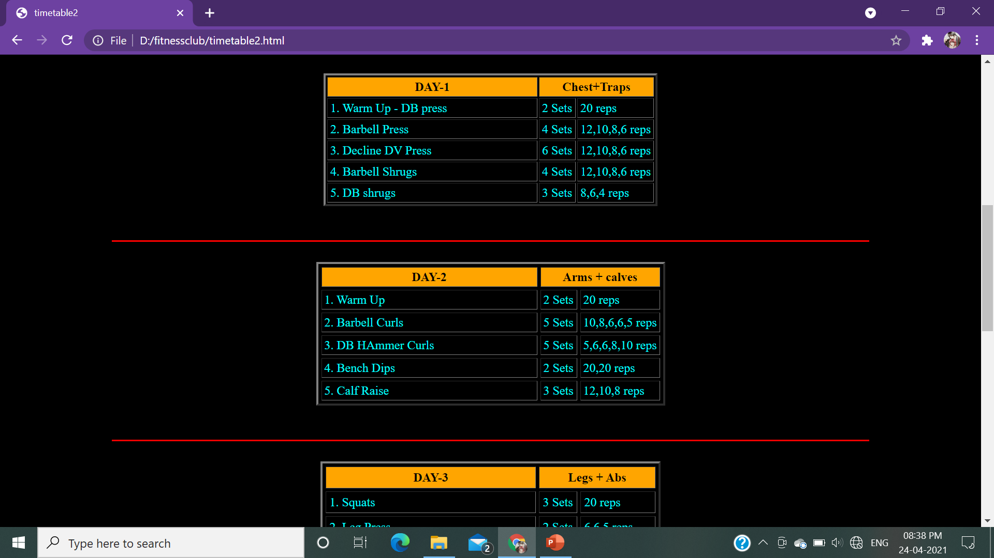
TimeTable Page
Developer: Aryaman Suri
A schedule on different types of training excercises
Day wise details
Tabular arrangement

Slide 5
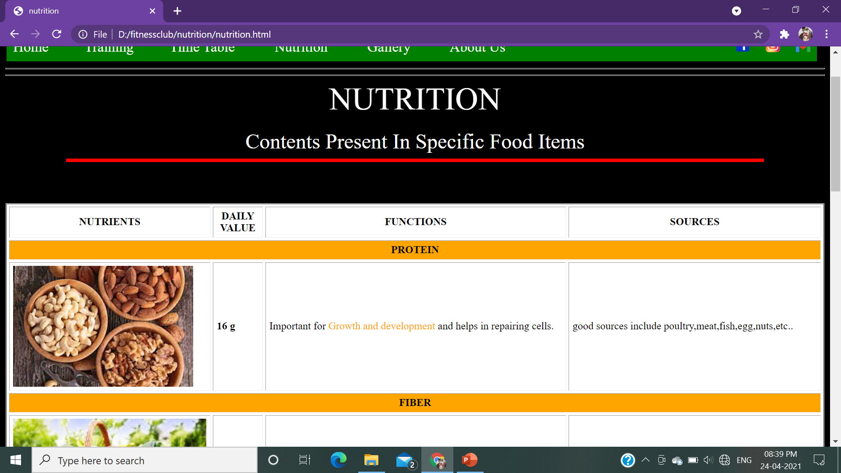
Nutrition Page
Developer: Aryaman Suri
Daily Nutrition guide
Tabular arrangement
Proper description depending on needs

Slide 6
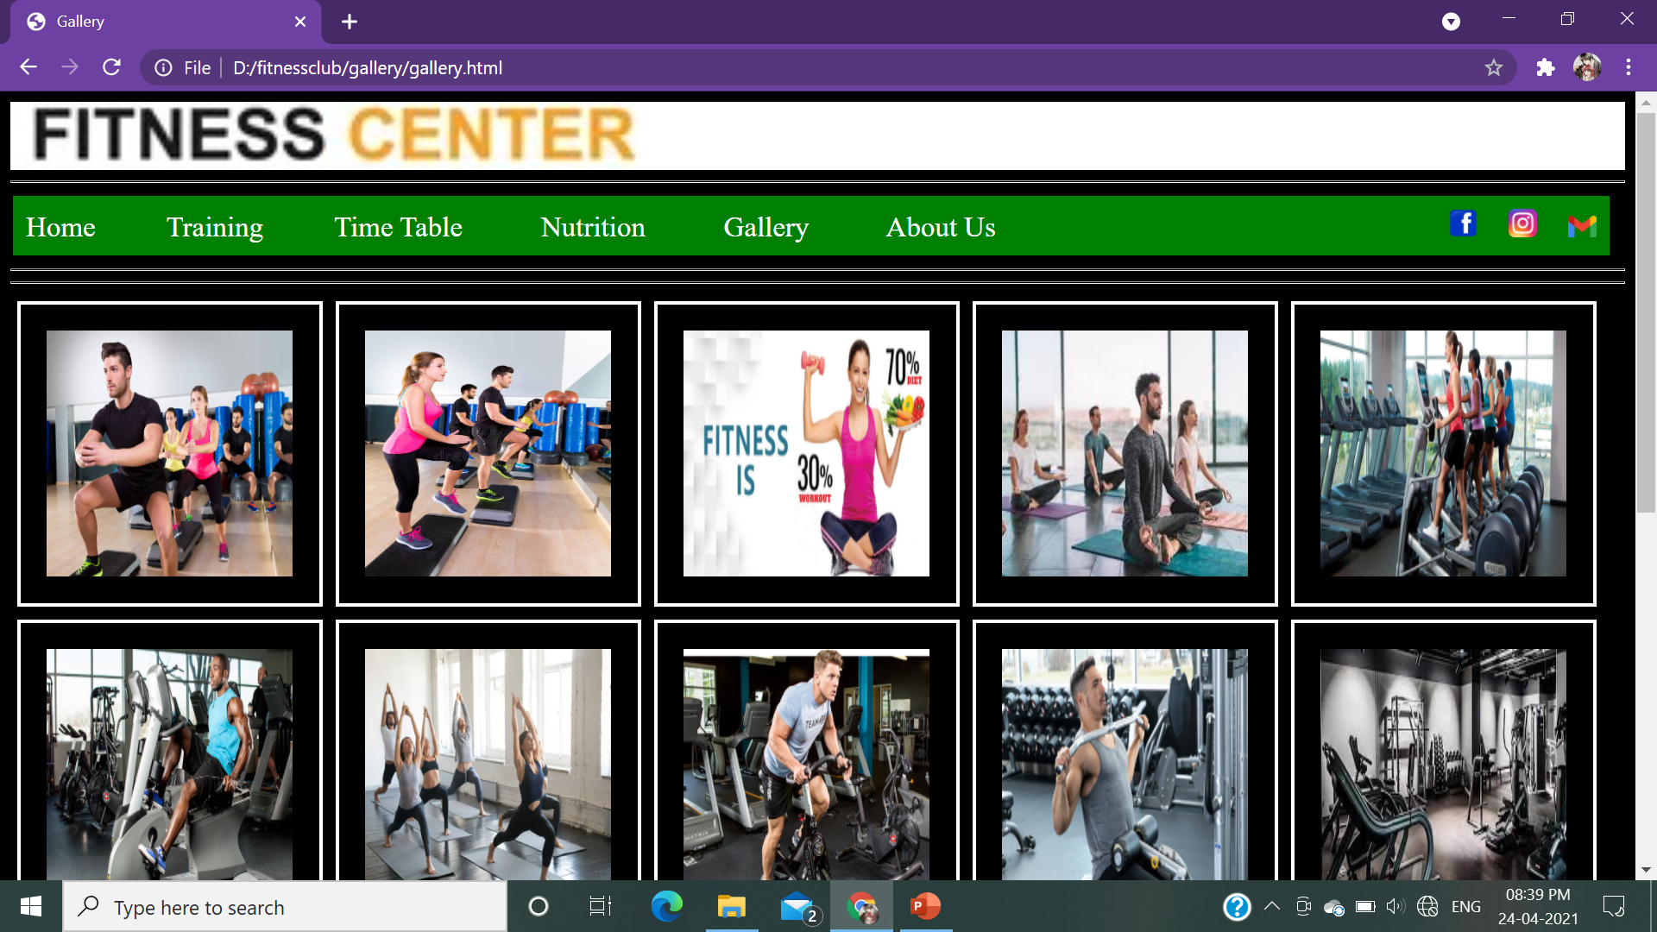
Gallery Page
Developer: Aprendu Aman
Collection of Fitness Center Photos
Well displayed in proper arrangement

Slide 7
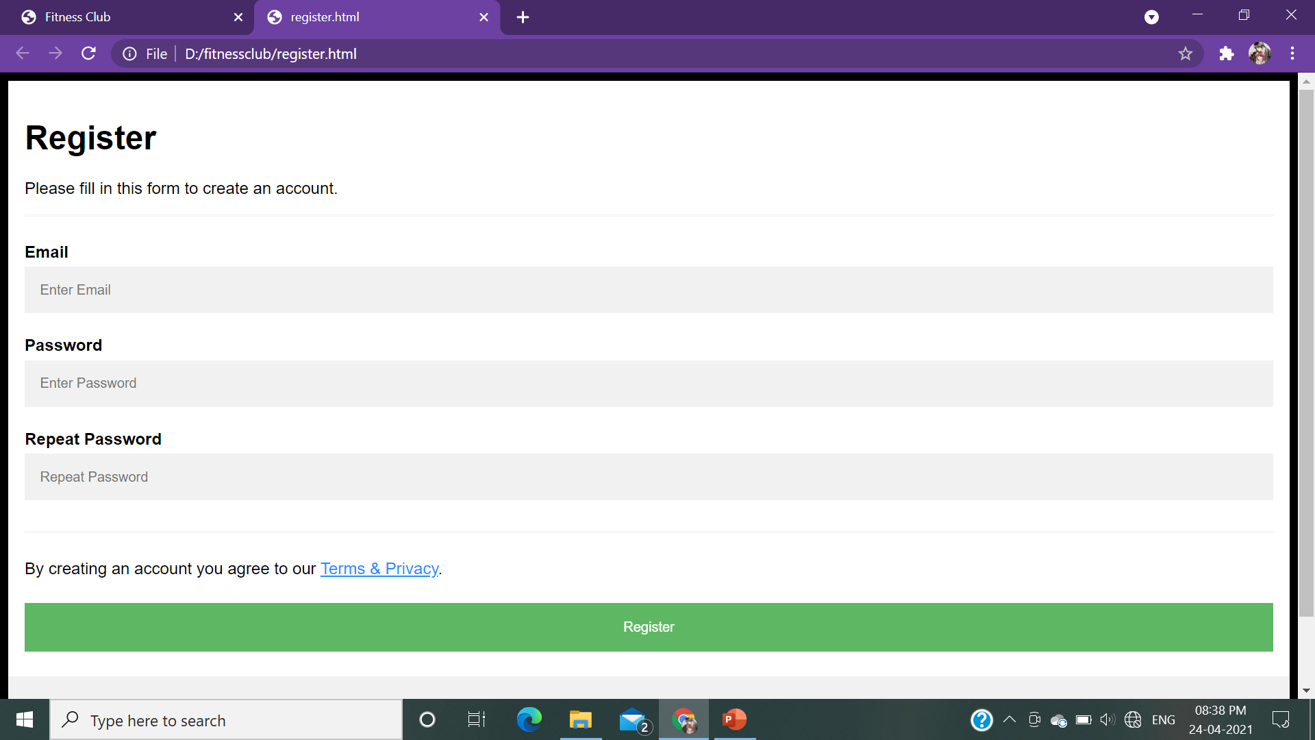
Register Page
Developer: Shivam Hooda
Simple form to register into the website
Opens in New tab, doesn’t disturb the flow of original website

Slide 8
Contributions
Md Imran Raj : Home Page
PPt Presentation
Aryaman Suri : Nutrition
Time Table
Aprendu Aman : Gallery
Project File
Shivam Hooda : Training
Registration

